Slide 1
Correlation
The measure that one trait (or behavior) is related to another

Slide 2
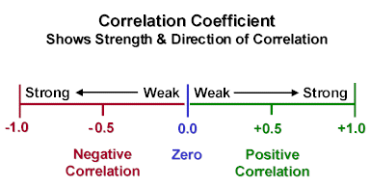
Correlation Coefficient
Expressed as an “r” value that ranges from -1 to + 1
Helps explain how closely two things vary together, which in turn lets us know how well one predicts the other
It shows the strength and direction of a relationship between variables

Slide 3
Types of Correlations
Correlations
No Correlation
Negative Correlation
(Inverse Correlation)
Positive Correlation
(Direct Correlation)

Slide 4
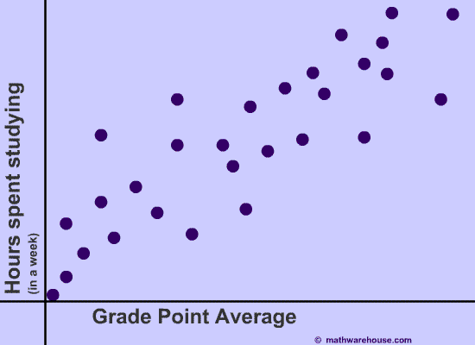
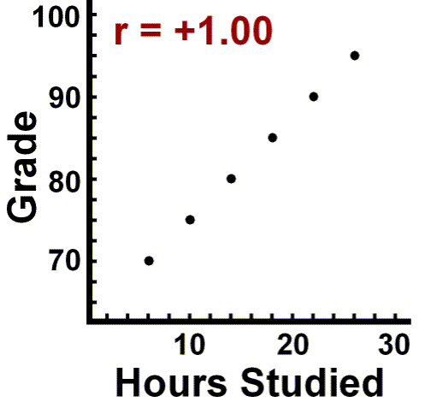
Positive Correlations
“r” value is positive
both variables (or quantities) increase or decrease together
Weak correlation
Perfect positive correlation
As gpa goes up, the number of hours spent studying goes up too
As the grade goes down, so does the number of study hours

Slide 5
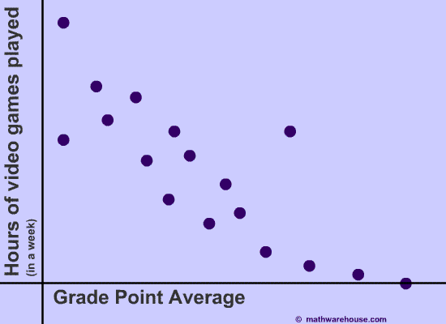
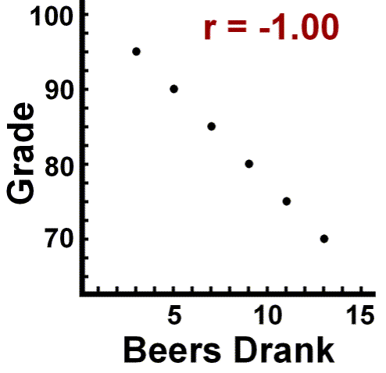
Negative Correlations
“r” value is negative
as one variable (or quantity) increases, the other variable decreases and vice versa.
Weak negative correlation
Perfect negative correlation
Gpa goes down as the number of video game hours goes up
As the grade goes up, the number of beers drank goes down

Slide 6
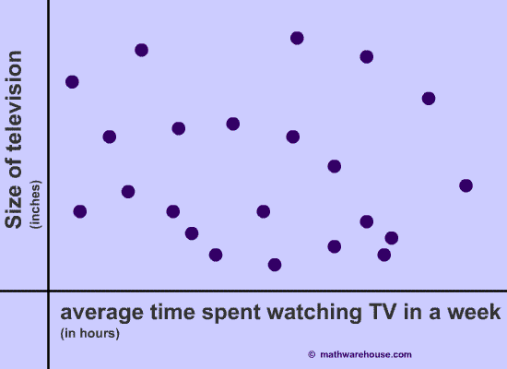
No Correlation
has an “r” value that is close to zero
“r” values can be (+) or (-)
shows a very weak association between the two variables (or quantities)
It is almost impossible to find an appropriate “trend” in the scatterplot. When this occurs, we say that one quantity (time spent watching TV) is not a good predictor of the other quantity (size of the TV)

Slide 7
Finding the Correlation Coefficient
input the data into your calculator (STAT, EDIT, enter L1, L2)
plot the data on your calculator
Turn STAT PLOT on
Change the WINDOW settings to match
the data set
GRAPH the data
calculate the “r value” (DIAGNOSTIC ON, STAT, CALC, 1-VAR STATS)
interpret the “r” value

Slide 8
Interpreting the “r” value of a correlation
The closer the “r value” is to + 1 or -1, the more you can predict the effect that one quantity has on another with strong conviction. Most statisticians believe < ± 0.8 shows a weak correlation.

Slide 9
Example Data Set
Literacy Percent | Life Expectancy
.29 | 42
.92 | 77
.52 | 58
.55 | 47
.40 | 48
.66 | 55
Input Data
Graph Data on Calculator
Calculate the “r” value
What does the “r” value say about the relationship between literacy percent and life expectancy?

Slide 10
The Measures of Central Tendency
Mean
Median
Mode
The sum of all the data divided by the number of data pieces.
The middle value when the data pieces are ranked in order from least to greatest.
The most frequently occurring number in a list of numbers… can be more than one (bi- or
tri – modal).
These assign a single number to a set of data. These measures only allow us to summarize the data we have. No conclusions can be made beyond the data.

Slide 11
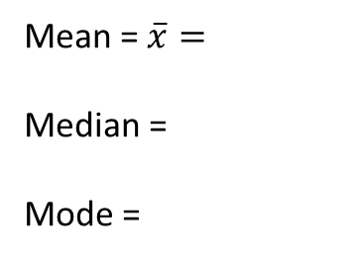
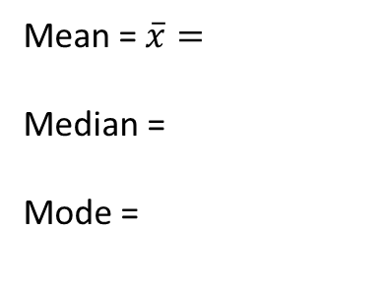
Calculating Mean, Median, and Mode
Input data into calculator (STAT, EDIT, L1,L2)
Calculate the values (STAT, CALC, 1-Var STATS)
Mean = $\overline{x}$
Median = Med
Mode = find it visually from list
Mean = $\overline{x}=$
Median =
Mode =
Mean = $\overline{x}=$
Median =
Mode =

Slide 12
Measures of Spread
Variance ($σ^{2})$
Variance (𝜎^2)
How similar or diverse the data points are
Averages derived from scores with low variability are more reliable than averages based on high variability
Standard Deviation($σ$)
Standard Deviation(𝜎)
Measure of how much scores vary around the mean score. Better gauge of whether scores are packed together or dispersed
If a group of scores has a small standard deviation, then you can draw more stable conclusions from the data set

Slide 13
Calculating Standard Deviation
$$σ= \sqrt{\frac{\sum{ {(x − \overline{x})}^{2}}}{n}}$$
$\sum{=}$the sum of
x = each individual term
$\overline{x}$ = the mean
n = number of terms in the set

Slide 14
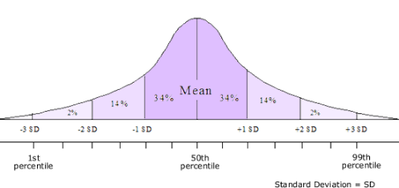
The Bell Curve
Large sets of data often form a symmetrical, bell-shaped distribution
THE NORMAL CURVE

Slide 15
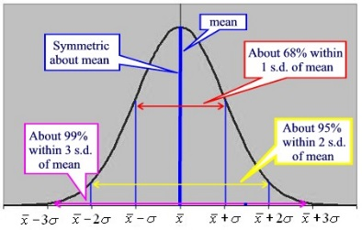
Interpretting the Bell Curve
68% of the data fall within 1 standard
deviation from the mean
95% of the data fall within 2 standard
deviations from the mean
99.7% of the data fall within 3 standard
deviations from the mean

Slide 16
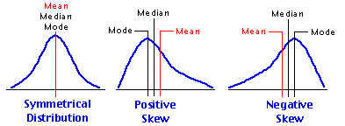
UNEVEN/SKEWED DISTRIBUTIONS
The Bell Curve
or
Normal Curve
Skewed Right most data is less than the mean
Skewed left
most data is more than the mean

Slide 17
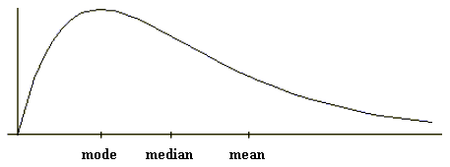
SKEWED RIGHT
A distribution that is skewed right, means that the tail extends to the right.
MEAN > MEDIAN
Example: 1,1,1,2,2,3,5,12, 17
What would cause this to happen?

Slide 18
SKEWED LEFT
A distribution that is skewed left, means that the tail extends to the left.
MEAN < MEDIAN
Example: Suppose a person is buying a house in Boulder County and asks you what houses typically cost. Would a mean or median be a better quote to state to the person?

Slide 19
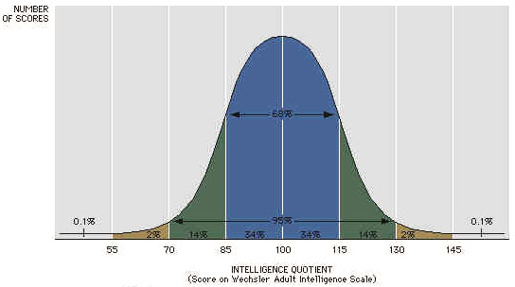
Interpretting Intelligence using Normal Curve
What is the probability that a random person scores less than 115 on the intelligence test?
P(<115) = 34% + 34% + 14% + 2% +.1%
= 84.1%

Slide 20
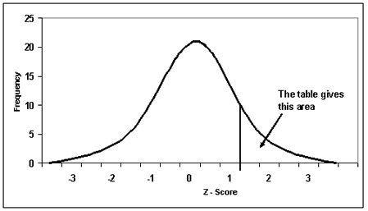
Calculating a Z-Score
$$z= \frac{x −\overline{x}}{σ}$$
The normal curve is standardized by assigning 0 to the mean and ±1 to 1 standard deviation, ±2 for 2 standard deviations, etc. This allows us to see what slice of the normal curve a piece of data fits in as a percentage.

Slide 21
UNDERSTANDING THE Z SCORE
Suppose a person scores a 112 on an intelligence test. The mean score was 100 with a standard deviation of 15.
$$z=\frac{112 −100}{15}= \frac{12}{15}=0.8$$
Because it is +0.8 it lies in the 34% slice
to the right of zero. This means they
scored 84% better than the others
that took the same test.

