Slide 1
Series of Paintings Analyze & Complete Entry Ticket
“Read” each painting.
For each painting write down 3-4 things that you notice.
What do you think a good title would be for this painting series.

Slide 2
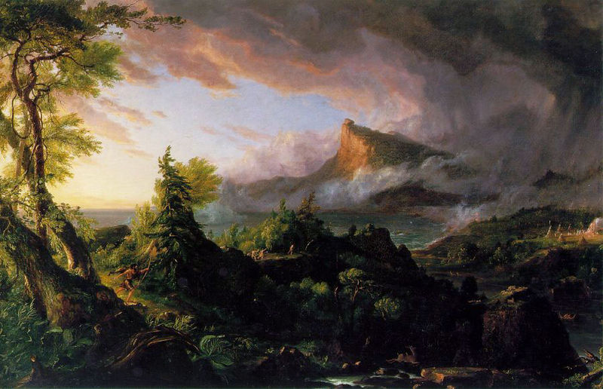

Slide 3
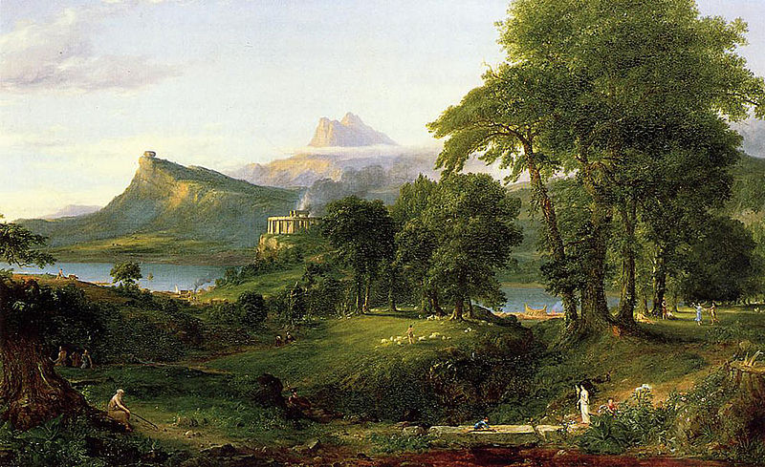

Slide 4
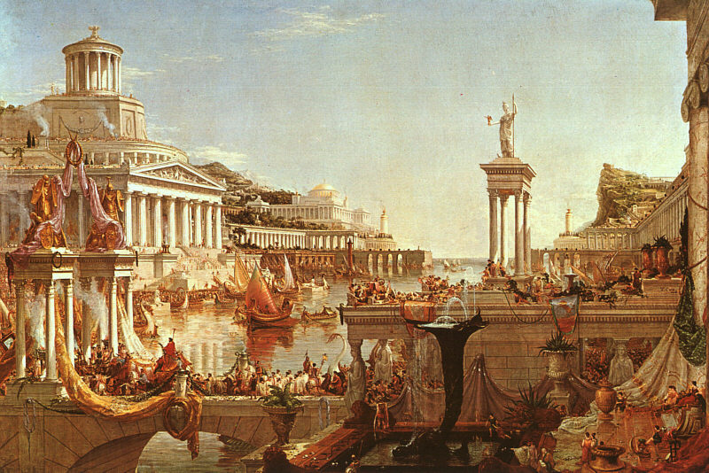

Slide 5
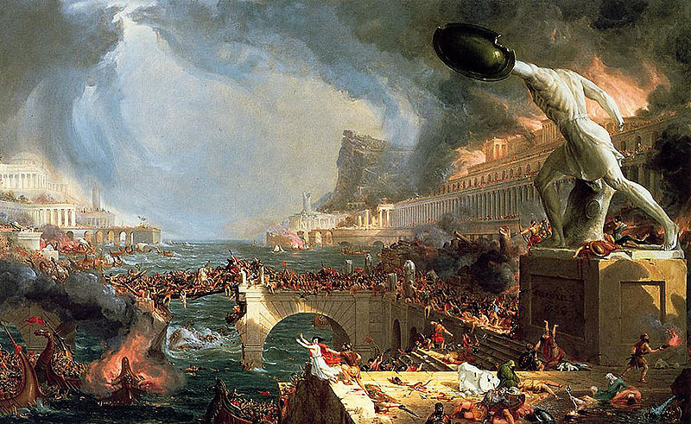

Slide 6
